Slide 1



Real-Time Emotion Monitoring System (REMS) for Autonomous Vehicles
Enhancing Safety and Passenger Experience

Slide 2
Content
Introduction: What is REMS?
Section 1: Old Model (DeepFace with dlib68)
Section 2: New Model (DeepFace and MediaPipe)
Section 3: The Bad Lighting Problem & Solution
Section 4: Testing Methodologies
Section 5: Model's Performance (Current System)
Section 6: Our Custom Model
Section 7: Future Work and Next Steps
Conclusion

Slide 3
Introduction
What is R.E.M.S?

Slide 4
Introduction: What is R.E.M.S?
Real-Time Emotion Monitoring System for Autonomous Vehicles.
Enhances safety and passenger experience in autonomous carts, specifically for elderly individuals in retirement homes.
Leverages computer vision and deep learning to analyze camera feeds for drowsiness, yawning, and emotional states.
Provides immediate visual feedback and warnings.
Designed for modularity and robustness.

Slide 5
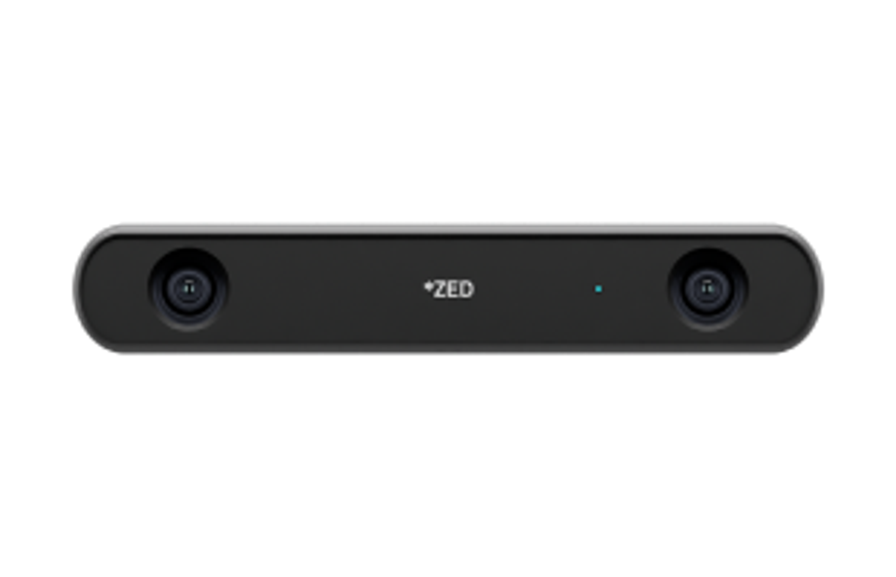




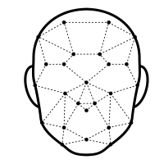



Introduction: System Architecture Diagram
Video Frames
Zed Camera
Image Processing and Enhancement
Logging & Analysis System
Fatigue & Alertness Analysis
Raw Camera Frames
Face Detection & Landmark Extraction
Visualization & Output
Manual Annotation to Generate Ground Truth Data
Bounding Boxes & Warnings Annotation

Slide 6
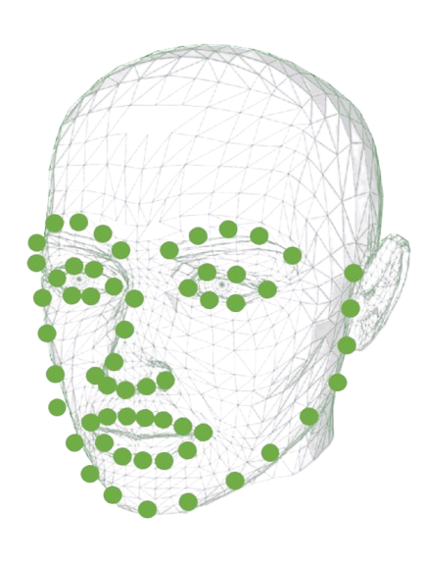

Section 1: Old Model (DeepFace + dlib68)
Pipeline:
Face detection: dlib68 (68-point landmark detector)
Emotion classification: DeepFace (pretrained)

Slide 7
Section 1.1: Problems Identified
Inconsistent detection with glasses or head turns.
Weak performance in low lighting.
No temporal smoothing → unstable predictions.
Only single-face detection.

Slide 8
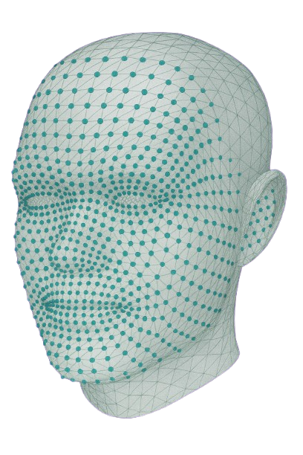
Section 2: New Model (DeepFace + MediPipe)
Accurate tracking of eyes, mouth, nose
Robust to partial face coverage (e.g., glasses)
Multi-face support and stable tracking
MediaPipe's Face Mesh solution estimates 468 3D face landmarks in real-time.
Result:
Much more reliable system for in-motion carts with variable lighting and multiple passengers.

Slide 9
Section 2.1: New Model's Core Functionality
Tiredness Detection:
Eye Aspect Ratio (EAR) for blinking/eye closure.
Mouth Aspect Ratio (MAR) for yawning.
Head Nod Detection: Compares the vertical displacement of the nose tip.
Emotion Correction & Smoothing:
Applies smoothing to avoid flickering/unstable predictions.
Logic to override fear or sad when facial context contradicts (e.g., fear downgraded to neutral if calm, sadness reclassified if mouth corners raised or EAR high).
Uses rolling emotion history for stability.
Visual Output: Real-time bounding box, emotion label, drowsiness/ yawning/ head nodding warnings, facial landmarks.

Slide 10
Section 3: The Bad Lighting Problem & Solution
Challenge: Emotion misclassification in low lighting or poor face angles.
Solution: Advanced Image Processing & Cropping:-
A new, tunable image processing function has been developed and integrated.
Enables enhancement of video frames for improved detection accuracy in all lighting conditions.
Can be adjusted as needed for different environments.
crop_and_enhance_passenger.py script specifically processes passenger camera images, cropping and enhancing them.
More reliable detection and analysis when lighting conditions change.

Slide 11
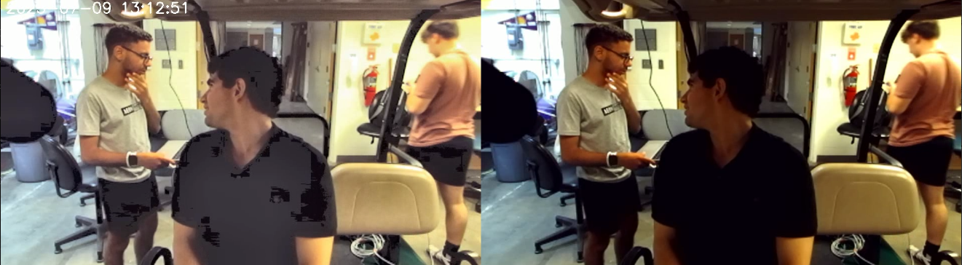
Section 3.1 : The Bad Lighting Problem & Solution Example
After
Before

Slide 12

Section 4
Testing Methodologies

Slide 13
Section 4.1: Testing Methodology - Overview
Comprehensive Analysis
Performed a comprehensive analysis of the model's performance using all available log files.
Automated Logging & Manual Annotation
Detected emotions and states are automatically logged at regular intervals during live tests.
After each test, raw video footage is manually reviewed and annotated to provide ground truth labels for each person at each timestamp.
This enables direct comparison between predicted and true emotions for quantitative analysis.

Slide 14

Section 4.2
Testing With Cameras

Slide 15
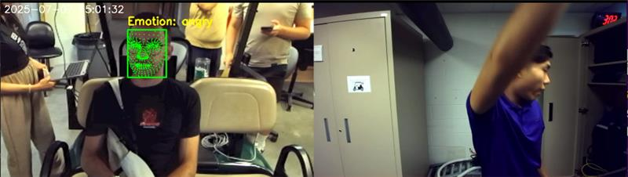
Section 4.2.1: Testing With Both Front And Back Cameras
Was done to assess the system's ability to detect passenger emotions and understand potential environmental influences from different camera perspectives.

Slide 16
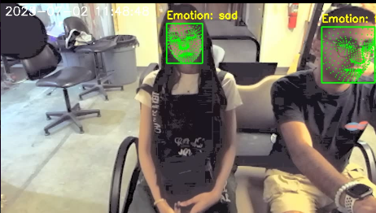
Section 4.2.2: Testing With Only The Back Camera
Helped with focusing on the model's performance, this is implied by the focus on the passenger monitoring system, where the "back camera" would be the primary one observing the passenger. The overall performance metrics are derived from this.

Slide 17
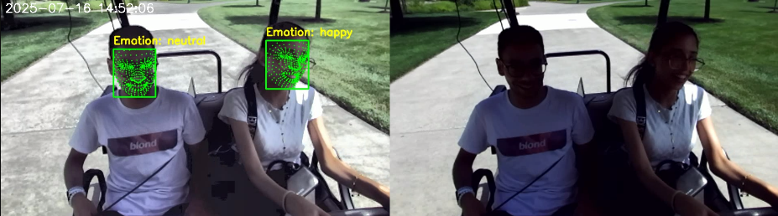
Section 4.3: Testing With Original Footage Next To The Detected Footage
Dual-Frame Video Recording with Logging:
The system outputs videos with both raw and processed frames side by side.
This makes it easier to compare detection results with the original footage and validate detections

Slide 18
Section 4.4: Manually Logging The Actual Passenger's Emotion Per Frame
This is a core part of the testing methodology for ground truth validation.

Slide 19

Section 5
Current Model's Performance

Slide 20
Section 5.1: Current Model's Accuracy
Overall Accuracy: 85% (Person 1), 84% (Person 2), 85% (combined). This demonstrates strong and consistent performance across different individuals.
Per-Emotion Accuracy
Happy
Sad
Angry
Neutral
Fear
91%
96%
95%
76%
96%

Slide 21
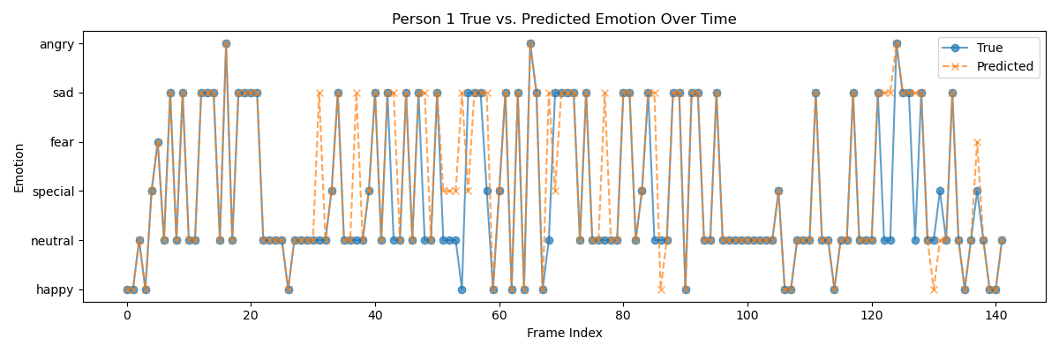
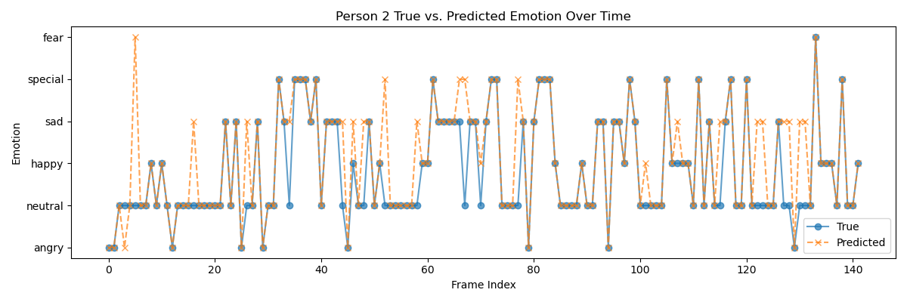
Section 5.2: Current Model's Metrics & Visualizations
Precision, Recall, F1-score (Examples):
Our model exhibits particularly high performance for 'Happy', 'Sad', and 'Angry' emotions, indicating robust detection in these categories.
Happy: Precision 0.88, Recall 0.91, F1 0.90
Sad: Precision 0.71, Recall 0.96, F1 0.81
Angry: Precision 0.92, Recall 1.00, F1 0.96
Neutral: Precision 0.99, Recall 0.76, F1 0.86
Fear: Precision 0.50, Recall 1.00, F1 0.67

Slide 22
Section 6
Our Custom Model

Slide 23
Section 6.1: Model's Architecture
Base: ResNet-18
A lightweight and efficient CNN backbone for feature extraction.
Enhancement: CBAM (Convolutional Block Attention Module)
Adds attention mechanisms to focus on the most relevant or important features
Dataset: FER2013 (7 emotions) (35,887 Images)
Preprocessing: Convert grayscale → RGB, resize to 224x224 and normalize pixel values using ImageNet mean & std
Augmentation: Albumentations library, random transforms like flip, blur, contrast, dropout to improve generalization.

Slide 24
Section 6.2: Model's Training
Multi-stage Training
Stage 1: Classifier head​ Train only the last layers first to help the model adapt gradually​
Stage 2: End-to-end fine-tuning Unfreeze the full model and fine-tune all layers for better accuracy

Slide 25
Section 6.3: Model's Techniques
Label smoothing: Helps prevent the model from becoming overconfident, so it leads to better generalization on unseen data.
Class weights: Handles class imbalance by giving more importance to rare classes.
Data augmentation: Applies random changes like flipping, cropping, and brightness adjustment to generate diverse training samples helping the model perform better on new, unseen images.

Slide 26
Section 6.4: Model's Challenges
Overfitting Risk​
Small dataset size made the model likely to memorize training data.​
Solution: Used data augmentation,
dropout, and early stopping.
Emotion Similarity​
Similar expressions (e.g., sad vs. neutral) caused confusion.​
Solution: Used CBAM and smoothing to improve distinction.
.

Slide 27
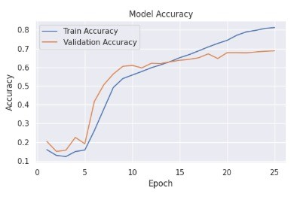
Section 6.5: Results
Total Accuracy is 70.0%
Accuracy improved steadily (Train & Val)
Validation accuracy peaked at 70%
Model Accuracy over Epochs

Slide 28
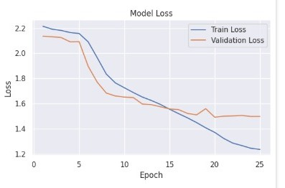
Section 6.5: Results
Loss decreased consistently
No signs of overfitting
Model Loss over Epochs

Slide 29
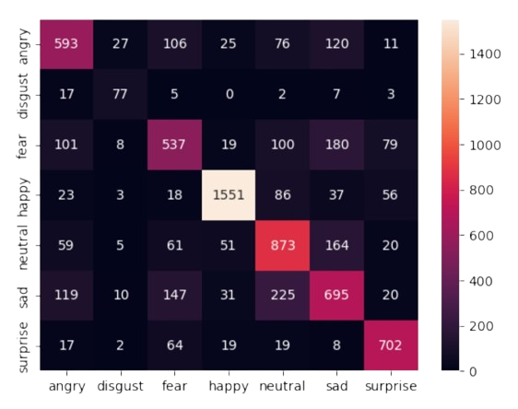
Section 6.5: Results
Best F1 (happy): 0.89
Macro F1 (7 classes): 0.68
Confusion Matrix: Shows how well the model predicted each emotion
Confusion Matrix – Predicted vs. Actual Emotions

Slide 30
Section 7: Future Work and Next Steps
Test the new pre-built (custom) model on live webcam/video data and evaluate its real-time performance.
Run both models (current and custom) side by side in real-time and directly compare their accuracy, stability, and robustness in practical scenarios.
Integrate additional sensors (e.g., heart rate, steering input) for multi-modal monitoring.
Expand emotion and fatigue detection to include more subtle cues and longer-term trends.
Deploy the system in real vehicles and collect more data for validation and improvement.

Slide 31
Conclusion
The REMS project has achieved significant advancements in image processing, emotion detection (with 85% accuracy for the current model), and overall system robustness.
It significantly enhances safety and passenger experience in autonomous carts, particularly for elderly individuals, by providing real-time monitoring of emotional and physical states.
The system ensures a secure and comfortable journey through immediate visual feedback and proactive warnings.

Slide 32
Thank you!

Slide 33
QA Time!

